Slide 1
Calculating Angles
KS2 Maths Practice Reasoning

Slide 2
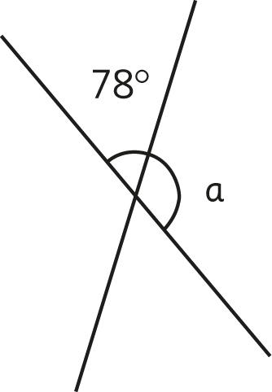
Calculate the missing angle marked with a letter in each of the following:
1
102˚

Slide 3
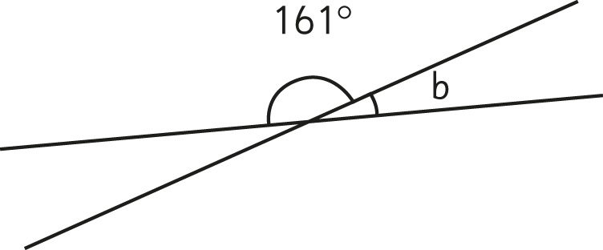
2
19˚

Slide 4
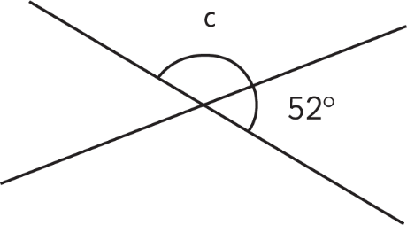
3
128˚

Slide 5
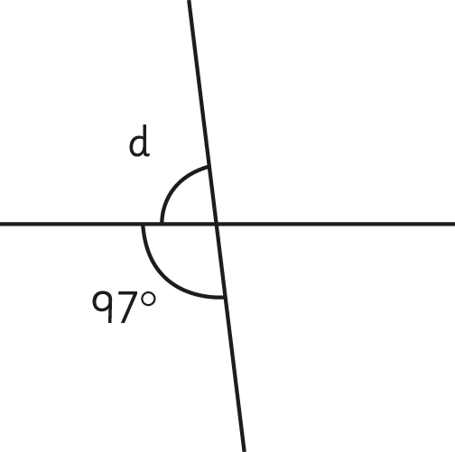
4
83˚

Slide 6
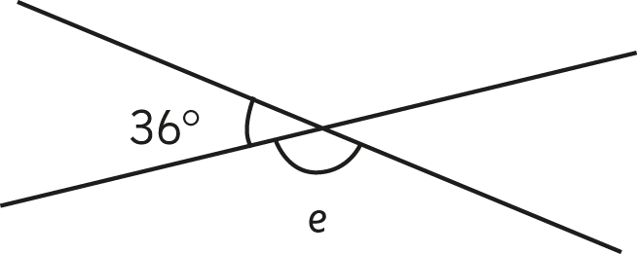
5
144˚

Slide 7
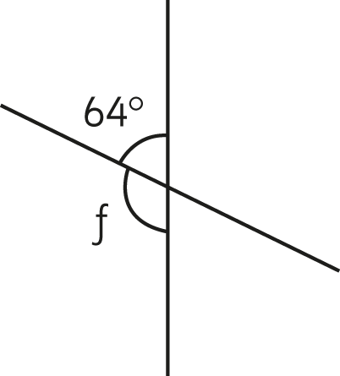
6
116˚

Slide 8
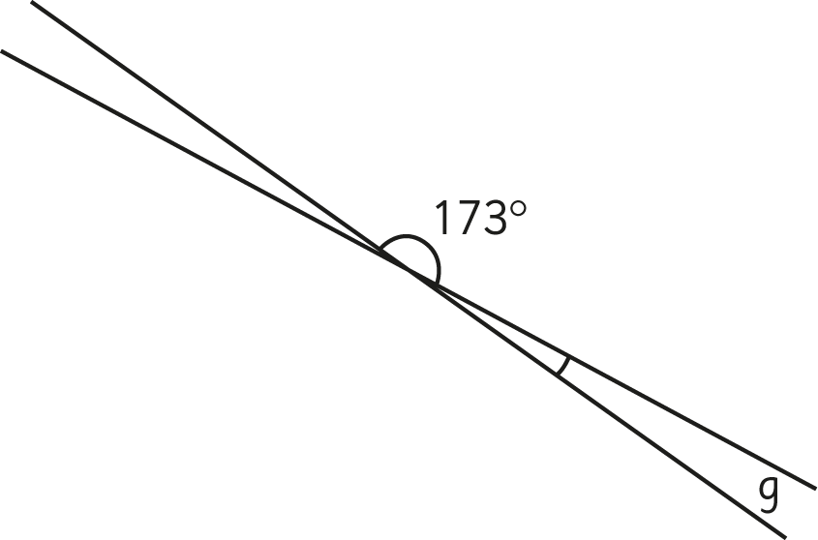
7
7˚

Slide 9
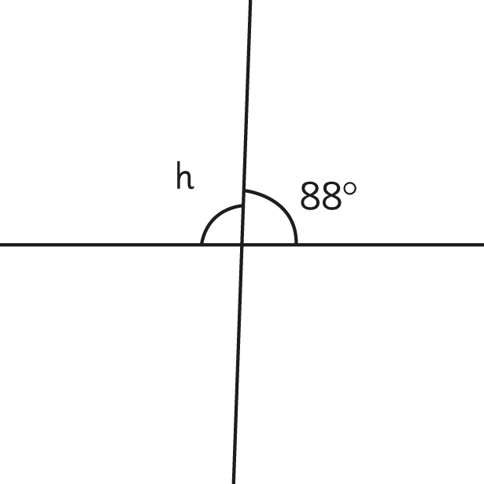
8
92˚

Slide 10
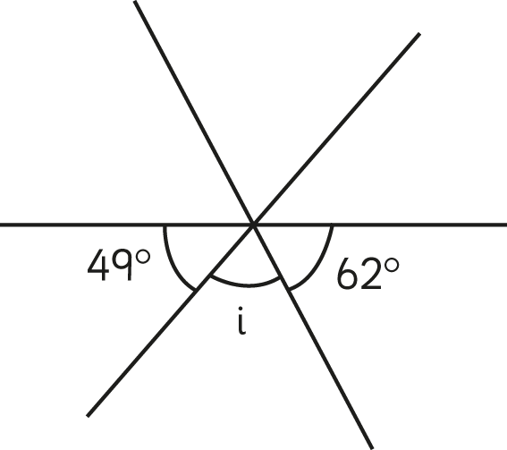
Calculate the missing angle marked with a letter in each of the following:
9
69˚

Slide 11
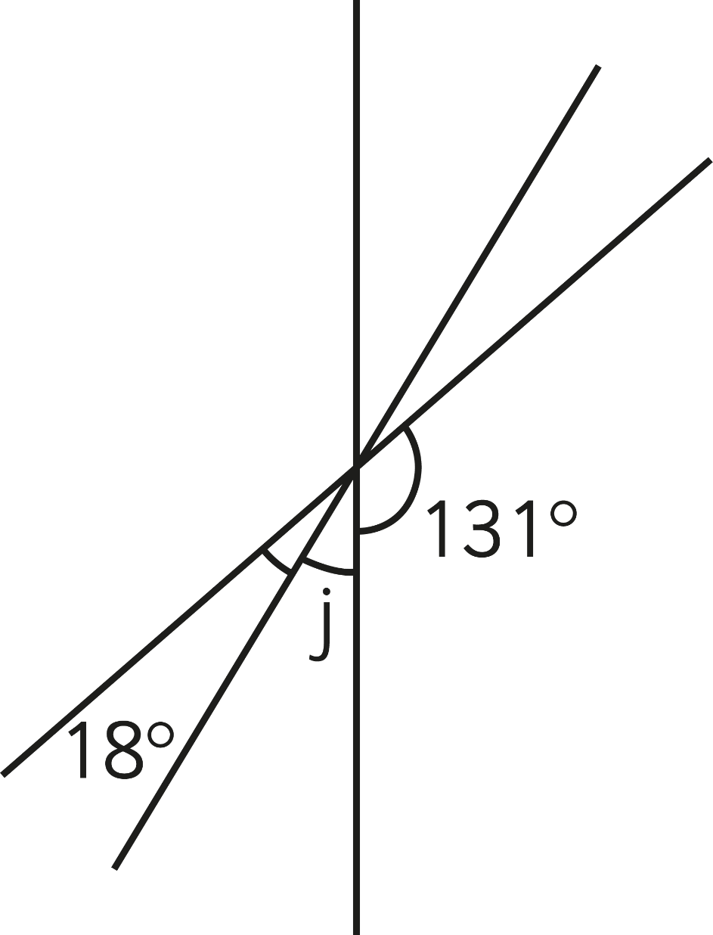
10
31˚

Slide 12
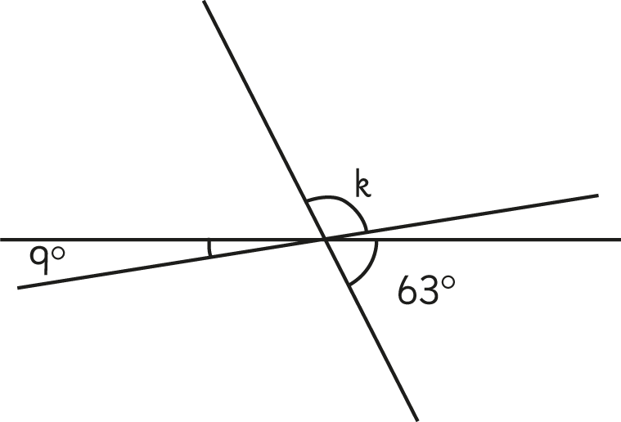
11
108˚

Slide 13
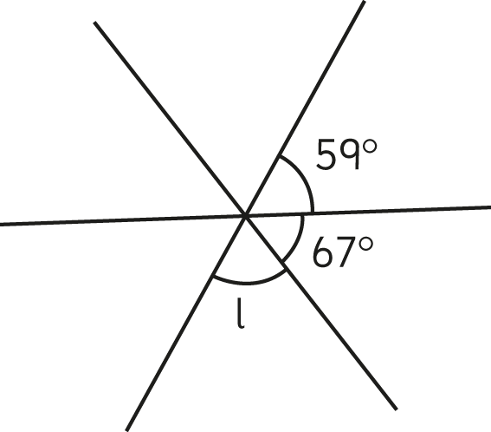
12
54˚

Slide 14
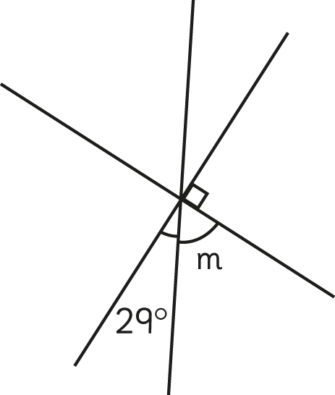
13
61˚

Slide 15
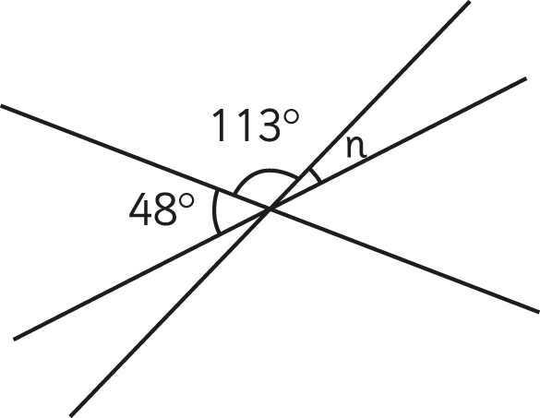
14
19˚

Slide 16
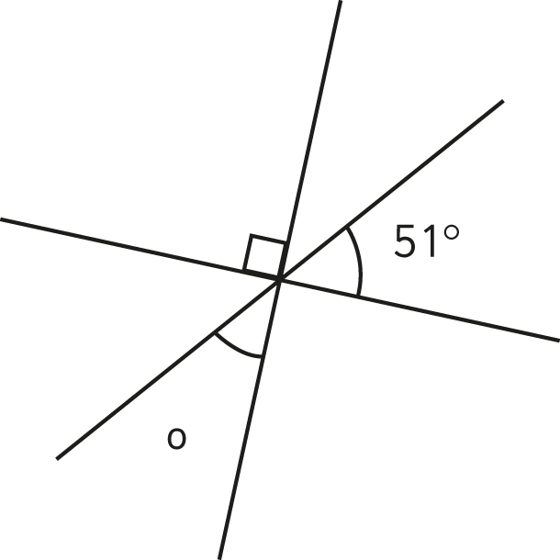
15
39˚

Slide 17
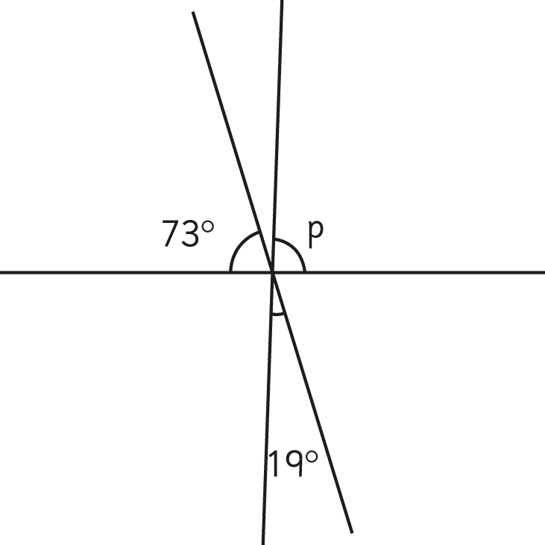
16
88˚

Slide 18
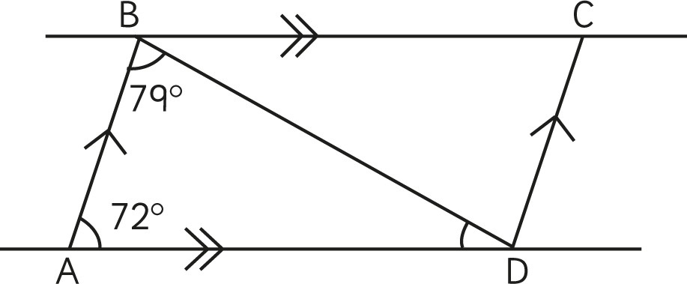
Calculate the angle in the following drawings:
BDA =
BCD =
17
29˚
72˚

Slide 19
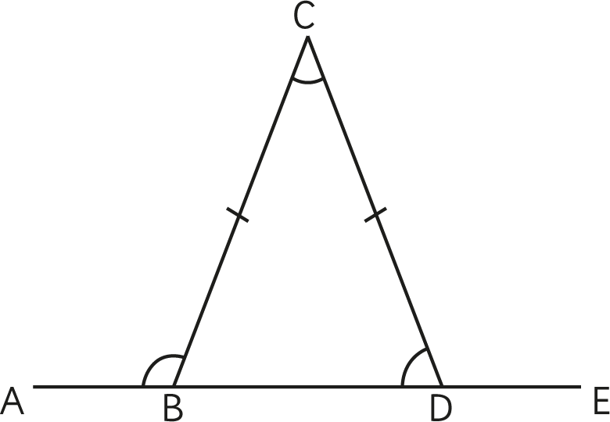
Calculate the angle in the following drawings:
ABC =
BDC =
18
111˚
69˚
42°

Slide 20
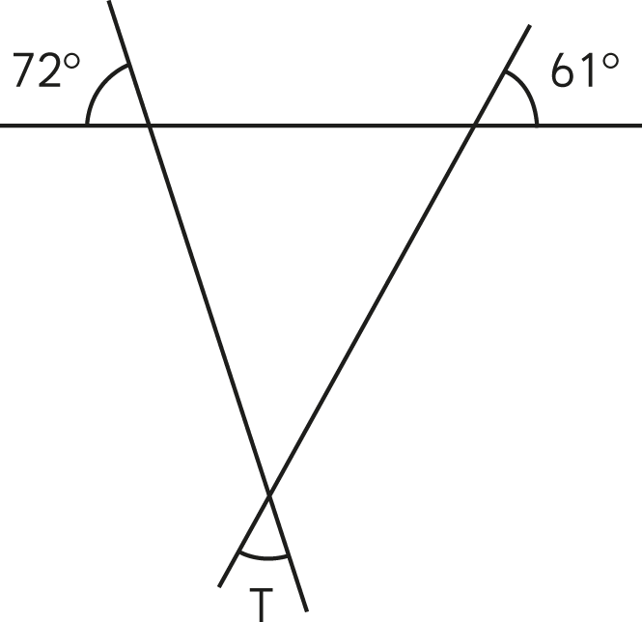
Calculate the angle in the following drawings:
T =
19
47˚

Slide 21
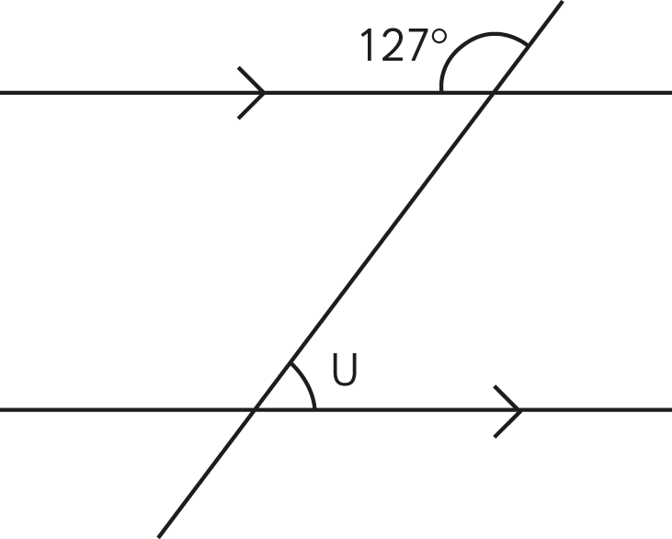
Calculate the angle in the following drawings:
U =
20
53˚

Slide 22
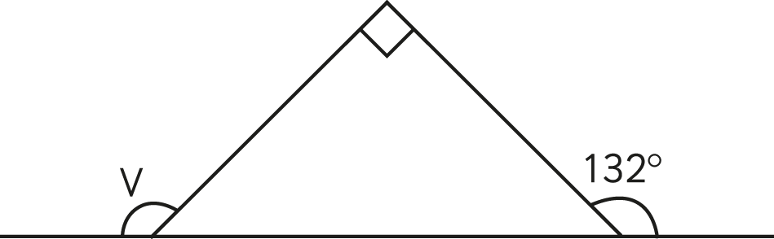
Calculate the angle in the following drawings:
U =
21
138˚

Slide 23
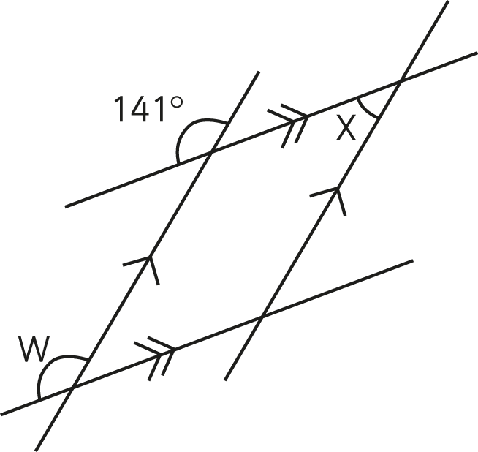
Calculate the angle in the following drawings:
W =
X =
22
141˚
39˚

Slide 24
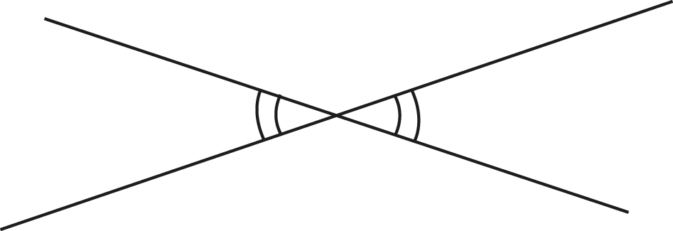
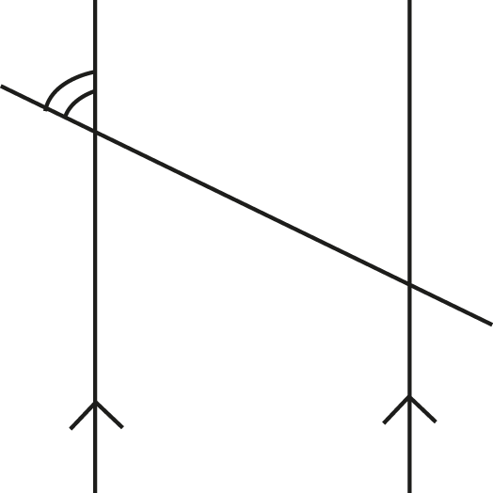
In each of the following drawings mark the angles that are equal to the given angle. Follow the example below:
23

Slide 25
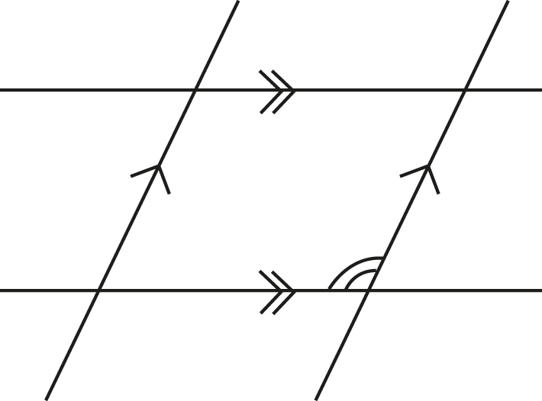
24

Slide 26
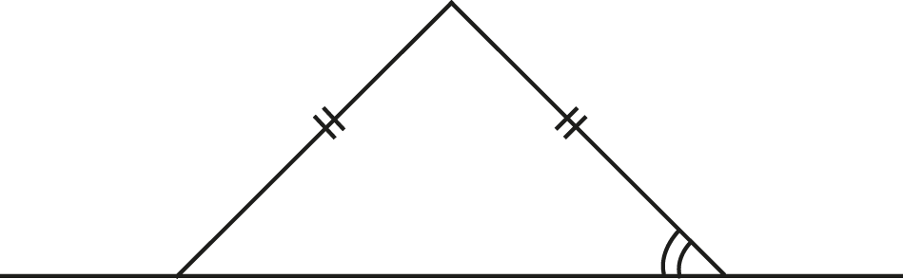
25

Slide 27
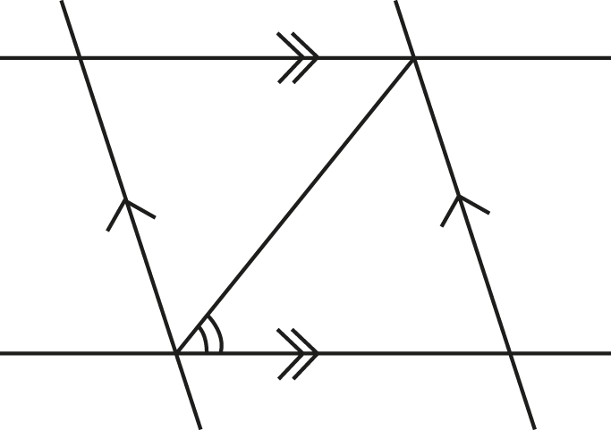
26

Slide 28
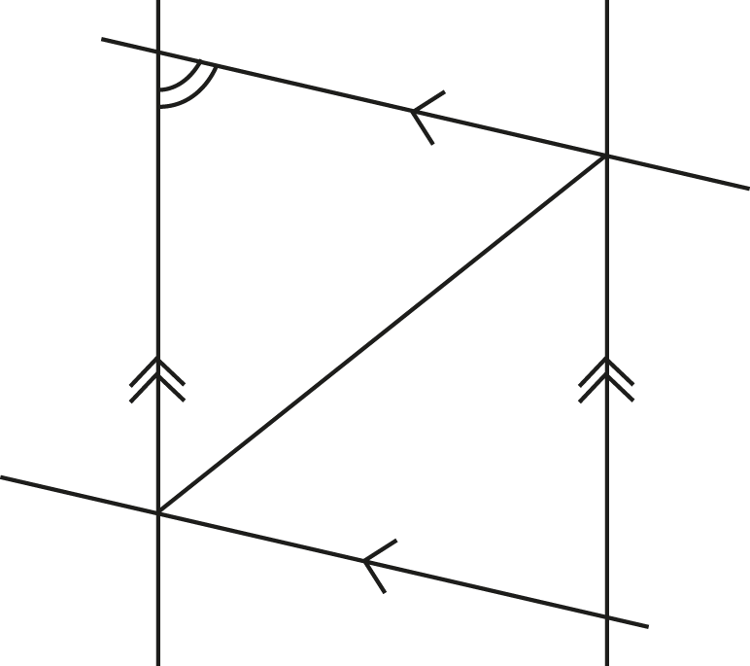
27

Slide 29
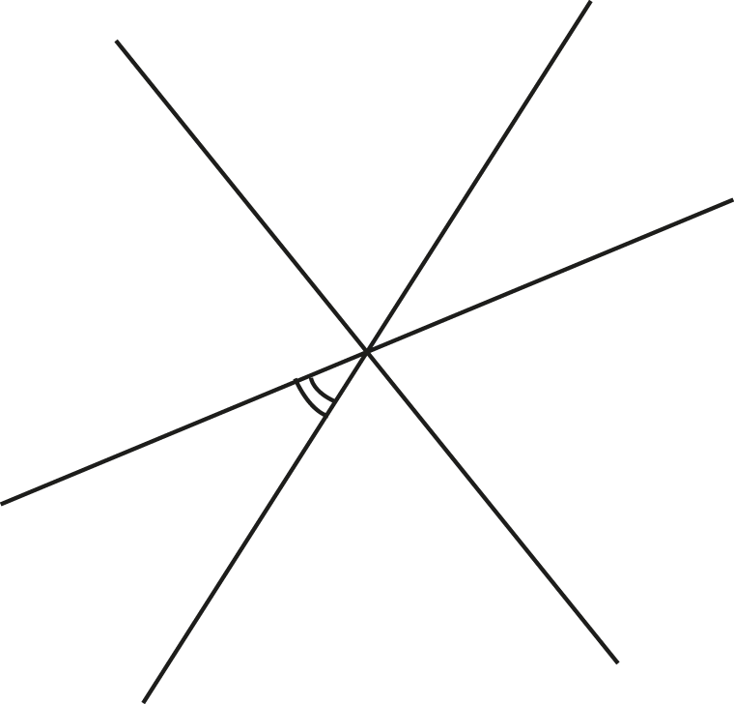
28

